Slide 1
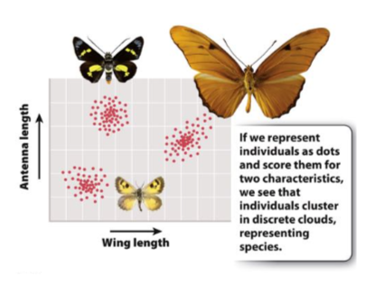

Slide 2
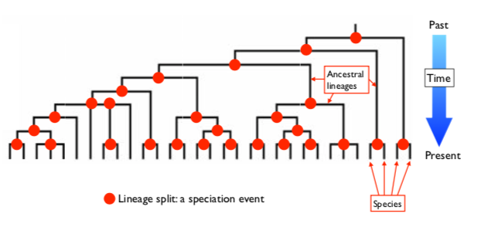

Slide 3
BIOLOGICAL SPECIES CONCEPT
CLOSED GENE POOL
REPRODUCTIVE ISOLATION
  Hybridization

Slide 4
REPRODUCTIVE BARRIERS
PREZYGOTIC
Ecological
Temporal
Sexual/Behavioural
Mechanical
Gametic incompatibility
2. POSTZYGOTIC
Hybrid inviability
Hybrid sterility

Slide 5
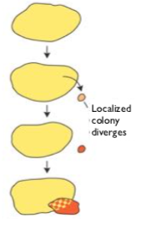
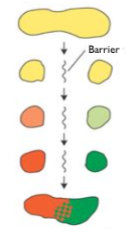
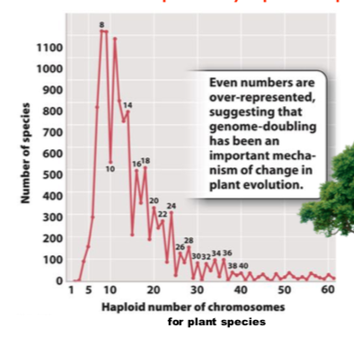
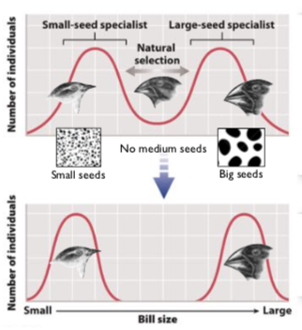
SPECIATION
ALLOPATRIC
SYMPATRIC
DISPERSAL
VICARIANCE
CHROMOSOMAL SPECIATION
DISRUPTIVE SELECTION

Slide 6
DISADVANTAGES OF SEXUAL REPRODUCTION:
Costly to have males
Risk of recombination
Aggravation
Disease

Slide 7
ADVANTAGES OF SEXUAL REPRODUCTION:
Evolvability
A) Lottery tickets: unpredictable environment
B) Red Queen Hypthothesis: think zebras and lions

Slide 8
TRIVERS-WILLARD: when mothers are healthy, they produce more boys
Intra-Sexual Selection: male-male competition
  strongest when male’s contribution is just sperm
Inter-Sexual Selection: female choice
  Fisherian Runaway model: positive feedback cycle

Slide 9
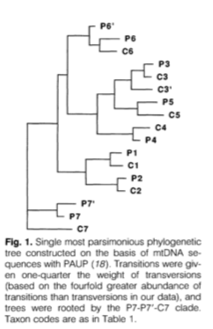
KNOWLTON ET AL 1993

Slide 10
Speciation Practice Question
I am lucky enough to have a time machine. I travel back 3 million years at a site in a volcanic region of central New Jersey and find a large, deep lake inhabited by two closely related species of fish. When I travel back towards the present, I pause at the 2 million years ago mark, and find that volcanic activity has caused the lake to split into two, with the two new lakes completely isolated from each other. At the 1 million years ago mark, I find that there has been more volcanism: one of the two lakes has split into three isolated lakes and the other into two isolated lakes. Now, finally back in the present, the first thing I do (naturally) is sample the fish in each of the five lakes and sequence their DNA with a view to phylogenetic analysis. Today I find a total of ten distinct species in the lake system.

Slide 11
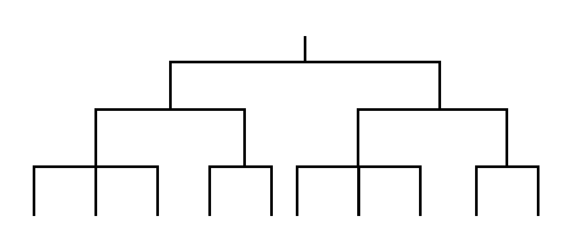

Slide 12
SECTIONS:
Museum tour:
  Agassiz biogeography and evolution
  Use of collections
Biston Betularia:
  Natural selection in action
  How could we disprove this or alternatives?
Spandrels:
  How should we respond as adaptationists?
  What is a spandrel?
Watson:
  The beauty of collaboration
  Doesn’t just take one man
Speciation and Vicariance

Slide 13
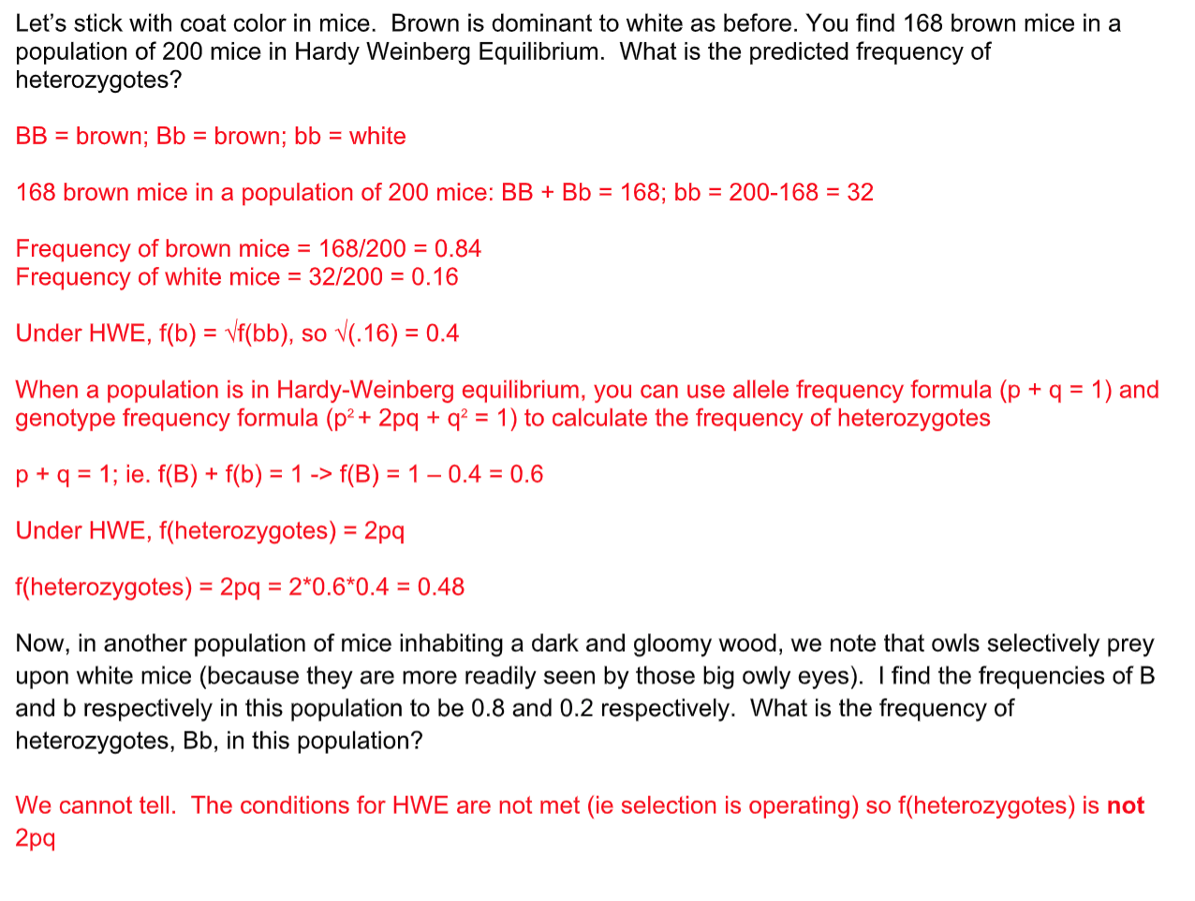

Slide 14
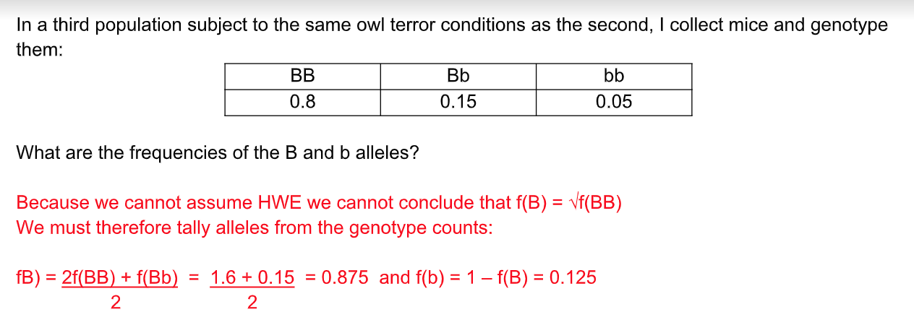

Slide 15
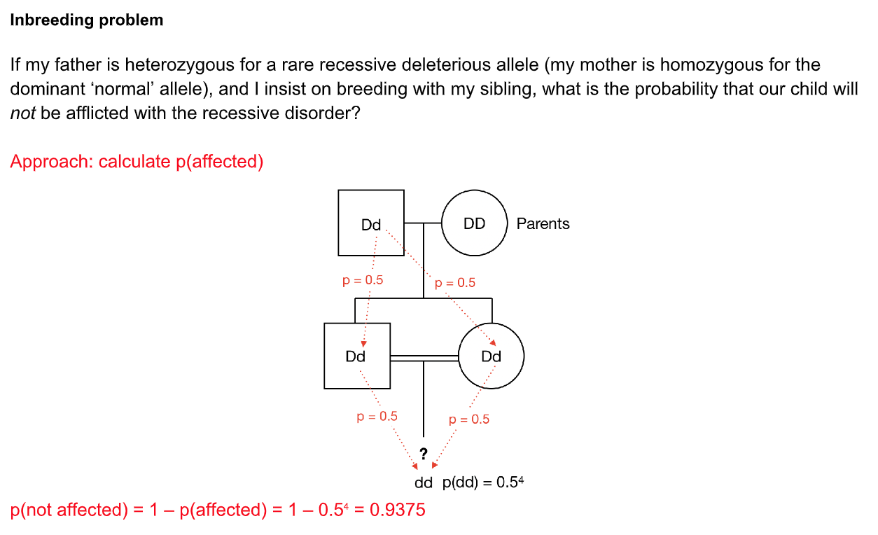

Slide 16
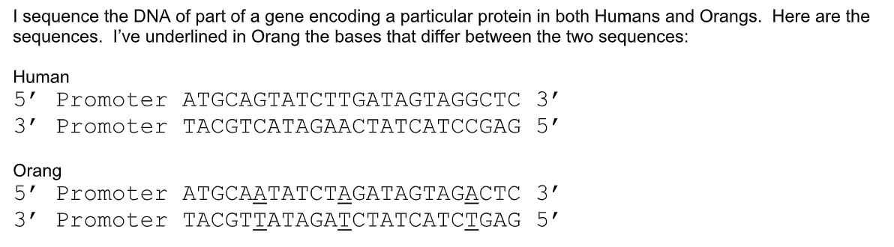

Slide 17
